Slide 1


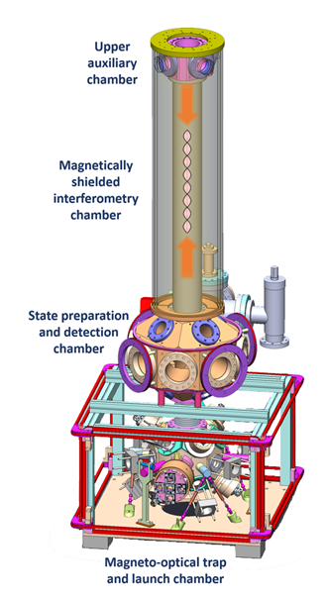
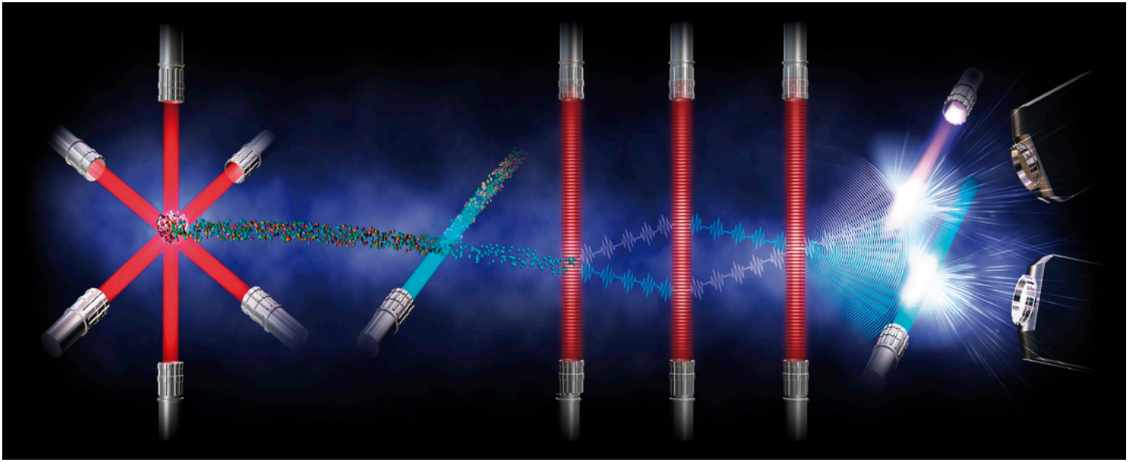
Experimental techniques for Atom Interferometry
Quantum Technologies Center
Dimitry Yankelev^{1,2} , Chen Avinadav^{1,2},
Nir Davidson¹, Ofer Firstenberg¹
¹ Weizmann Institute of Science
² Rafael Quantum Technologies Center
dimitry.yankelev@weizmann.ac.il
chen.avinadav@weizmann.ac.il
MICEcon, Novemeber 2019

Slide 2
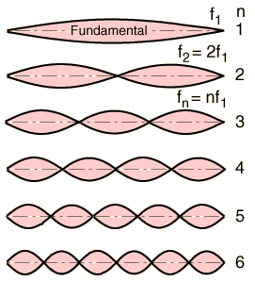
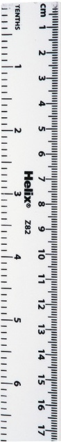
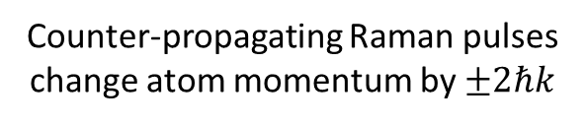
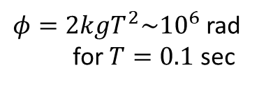
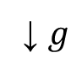
Atom interferometers – in a nutshell
Analogous to the optical Mach-Zehnder interferometer
Coherent manipulation of cold atoms with laser fields
Intuition:
The laser beams create a “ruler” that measures the atoms at each pulse, from which the motion is inferred.
“beam-splitter” π/2-pulse
“mirror” π-pulse
“beam-splitter” π/2-pulse
z
↓ $g$
Counter-propagating Raman pulses change atom momentum by $±2ℏk$
T
T
t
Δ
|e>
k₂
Interference phase proportional to acceleration of atoms (gravity):
k₁
k₂
Very high resolution (10⁻¹⁰ g) with absolute atomic accuracy
k₁
$φ=2kgT^{2}\sim {10}^{6}$ rad for $T=0.1$ sec
|2,p+ħk₂>
|1,p-ħk₁>
(also possible to measure horizontal accelerations, rotations, gradients, etc.)

Slide 3
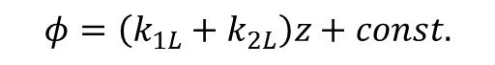
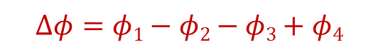

A bit more in depth
Interferometric phase
Atom optics: two photon transitions
z
↓ $g$
Δ
|e>
k₂
k₁
k₂
k₁
|2,p+ħk₂>
$$z$$
T
T
t
|1,p-ħk₁>
$$φ=\left(k_{1L}+k_{2L}\right)z+const.$$
$$Δφ=φ1−φ2−φ3+φ4$$
$$=2k(z1−z2− z3+z4)=2kgT2$$
(Independent of x₀, v₀)
+ Optical / Electronic phase between lasers

Slide 4
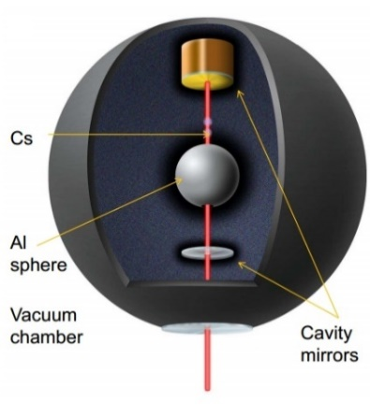
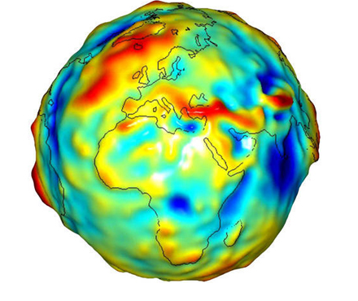
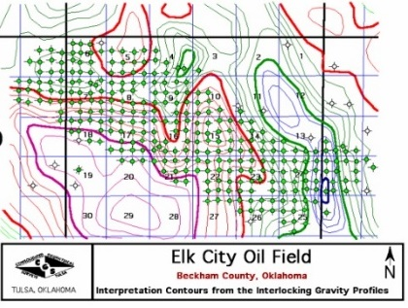
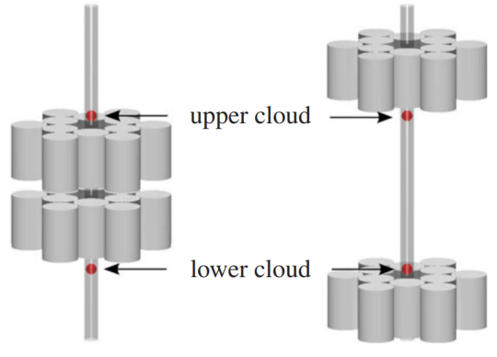
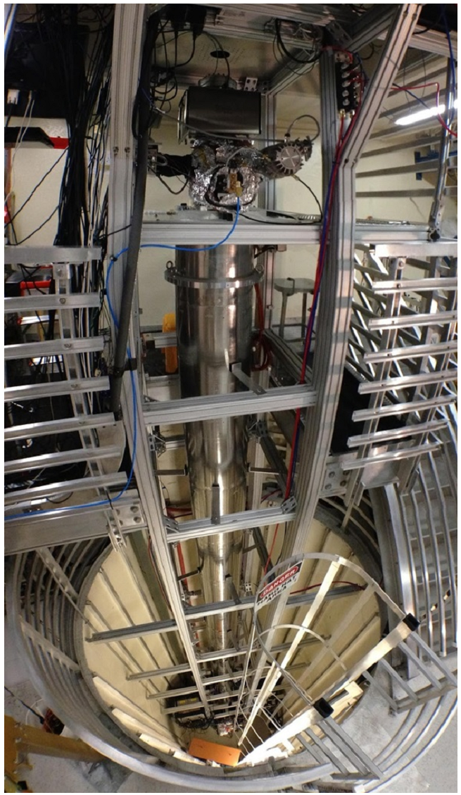
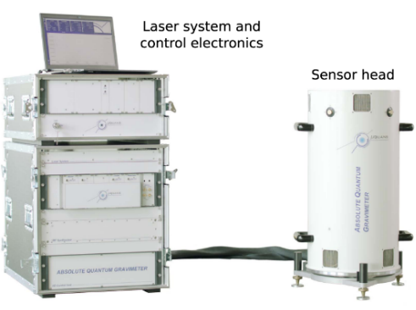
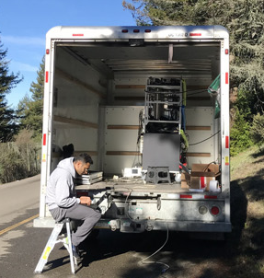
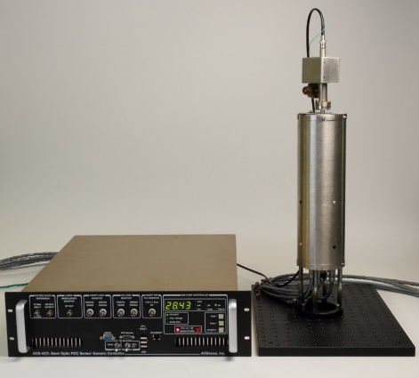

Atom interferometers – applications and realizations
Fundamental science (“In the lab”)
Applicative science and industry (“In the field”)
Geophysical gravity mapping and studies
Searching for minerals – oil, diamonds, etc.
Searches for dark energy
P. Hamilton et al., Science 349, 6250 (2015)
Portable cold atoms gravimeters
Precision measurement of the Gravitational Constant
G. Rosi et al., Nature 510, 518–521 (2014)
muQuans, France
g_{Rb}
g_{Cs}
Tests of Einstein’s equivalence principle
Berkley,
USA
AOSense, USA

Slide 5
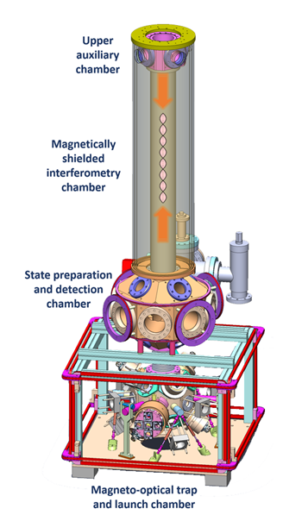
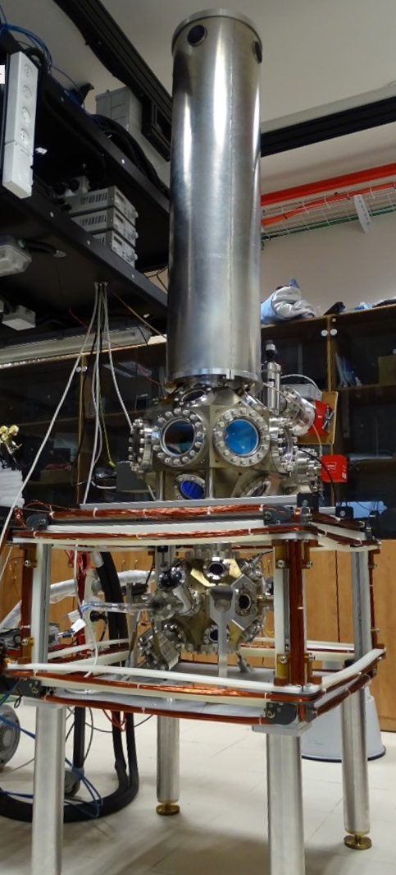
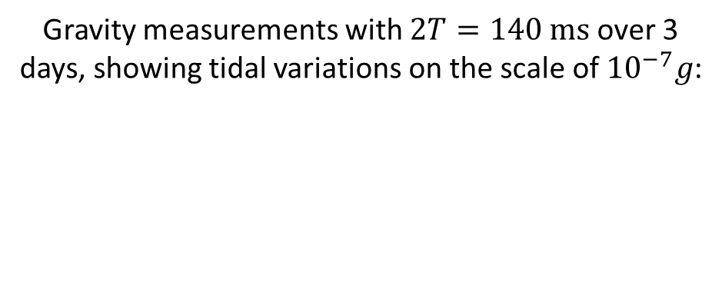
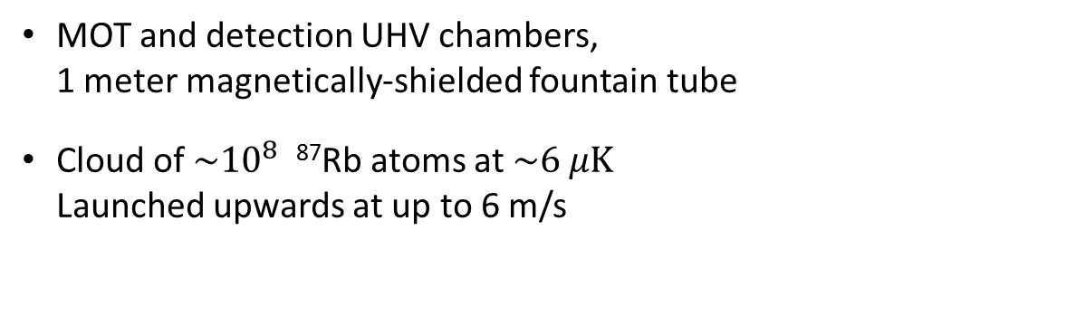
Our cold atoms interferometer
MOT and detection UHV chambers, 1 meter magnetically-shielded fountain tube
Cloud of $\sim {10}^{8}$ ⁸⁷Rb atoms at $\sim 6 μK$ Launched upwards at up to 6 m/s
Gravity measurements with $2T=140 ms$ over 3 days, showing tidal variations on the scale of ${10}^{−7}g$:
Also possible to create spatial interference fringes across the cloud for, e.g., gryo

Slide 6
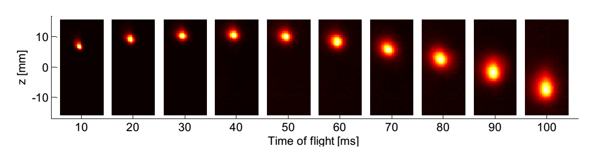
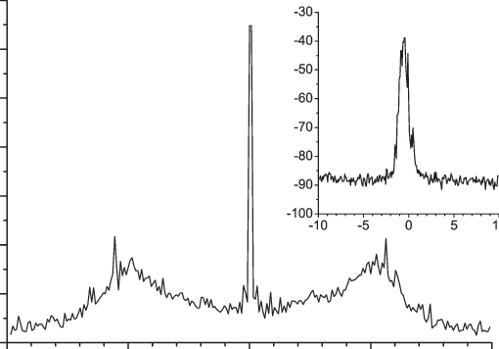
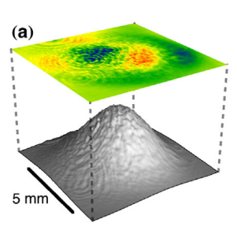
What we’ll talk about
Atomic trajectory – MOT and chamber
Raman beams generation
Phase uniformity and stabaility

Slide 7
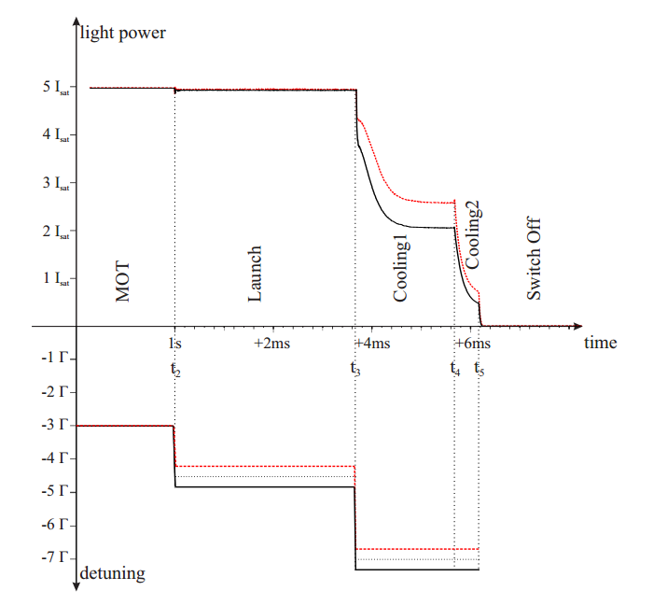
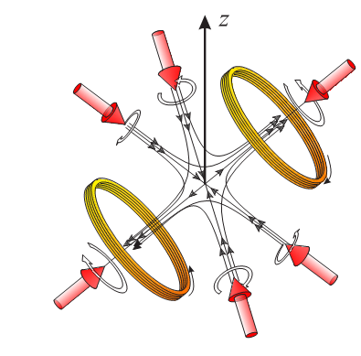
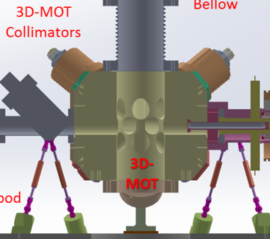
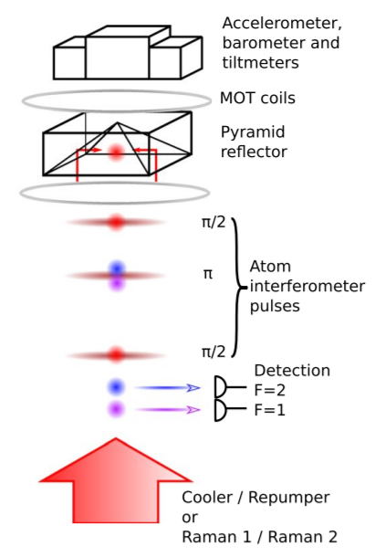
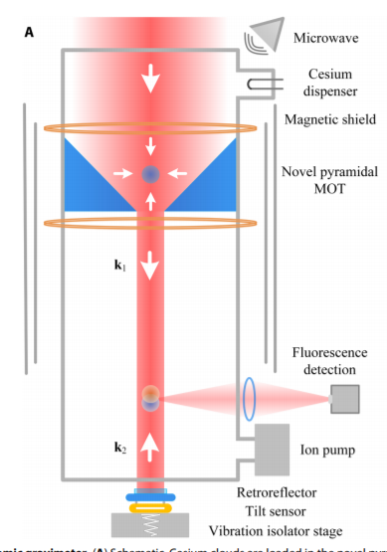
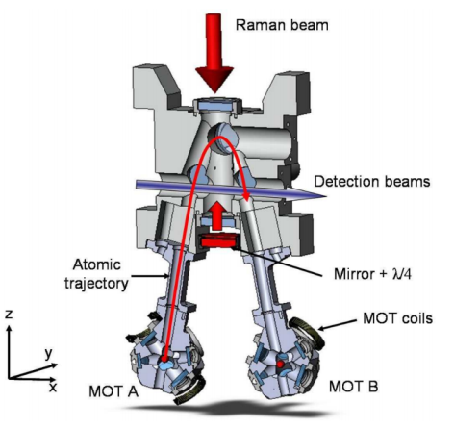
Atomic trajectory - MOT and chamber
Launch:
Maximal TOF out of given chamber (fountain)
Non 1D trjectories
Moving Optical Molasses
For symmetry: 111 configuration
Freefall:
Simplification of setup
Pyramid MOT
(Lattice Launch)

Slide 8
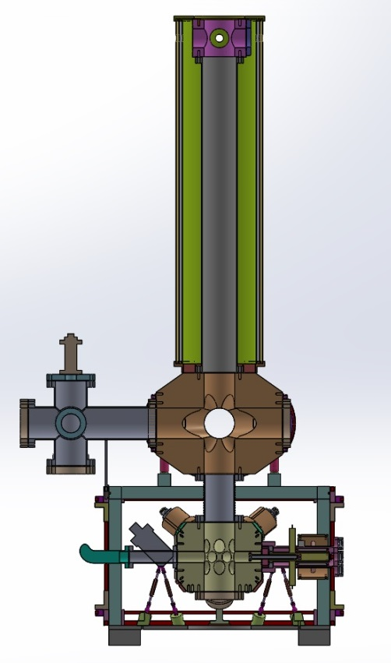
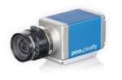
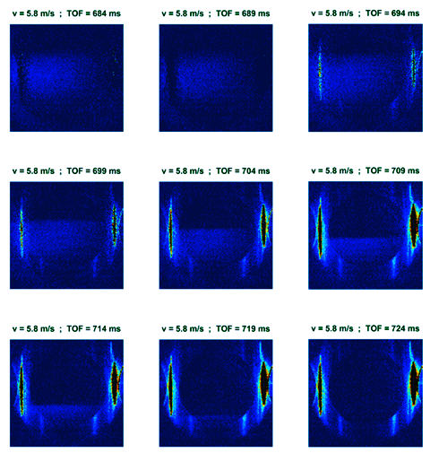
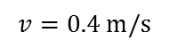
Launch
100cm
Detection beam size
15cm
Actual cloud size
$$v=0.4 m/s$$
43cm

Slide 9
Raman beams generation
Need stable and narrow beatnote between the two lasers
(otherwise Raman transitions too noisy)
Method one:
Optical Phase Lock Loop
Method two:
Electro-optical modulator
F=2
F=1
F=2
F=1
To atoms
Laser 1
To atoms
Laser 1
EOM
2x2
Freq. source
Laser 2
PD
PLL
Freq. source
Generates extra sideband, separation only with FP, limited control over relative intensities.
Advantage: we got it to work…
Convenient, apparently works well with ECDL lasers, but not with our DBRs…

Slide 10
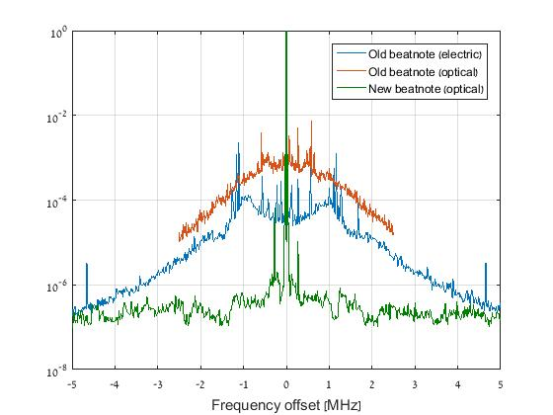
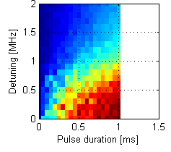
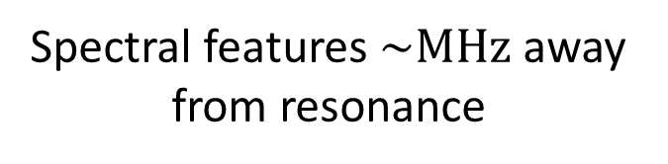
Effect of imperfect locking
Spectral features $\sim MHz$away from resonance
~1 Hz line, 30 dB over background, >90% of power in the peak…
And it’s far from being good enough
OPLL between DBRs
Beatnote from EOM
… and (practically) no Raman Rabi Oscillations
Not only us…
Toptica falc data for fraction of power in coherent peak:
99.5% for two ECDLs
86% for two DBRs

Slide 11
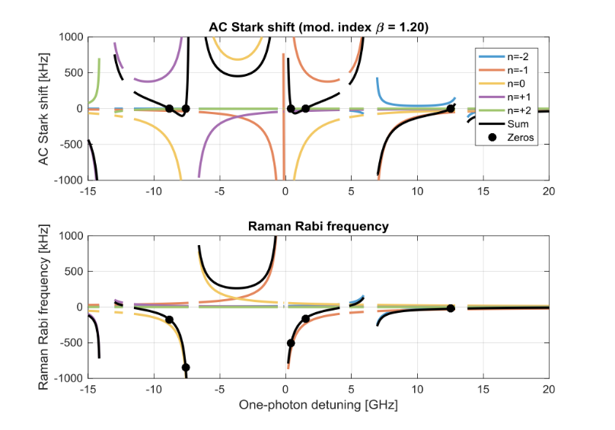
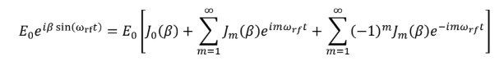
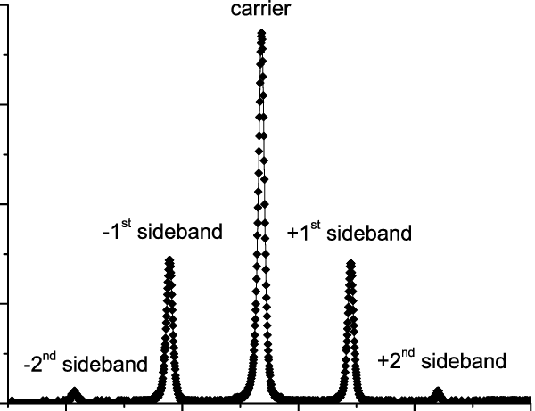
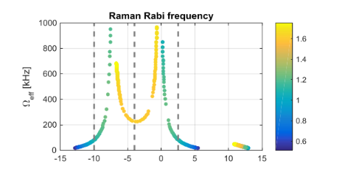
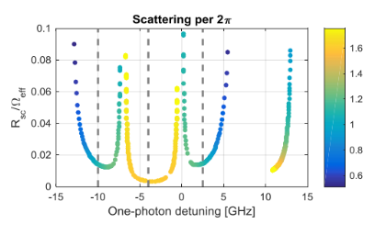
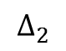
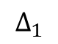
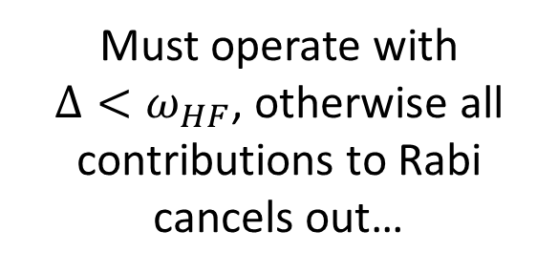
Raman with (unfiltered) EOM
$$Δ_{1}$$
$$Δ_{2}$$
Must operate with $Δ<ω_{HF}$, otherwise all contributions to Rabi cancels out…
Still need to take into account all beams for estimations of Light Shift and Scattering

Slide 12
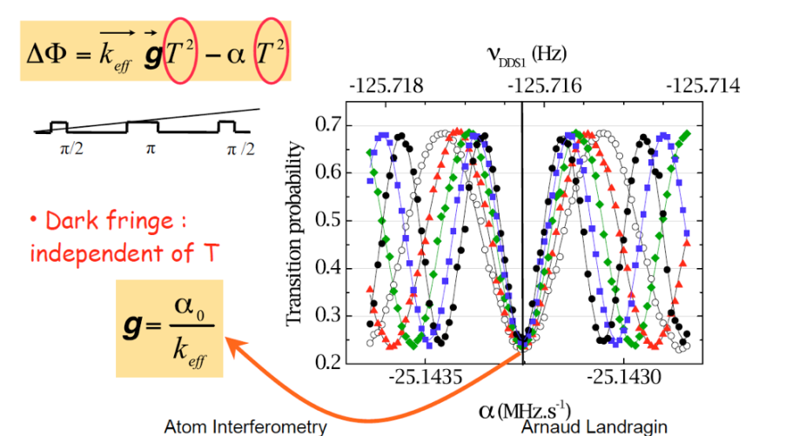
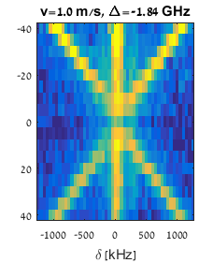
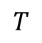
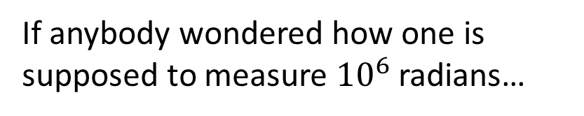
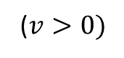


Raman spectrum and AI phase
Center peak : Doppler free
($v>0)$
($v>0)$
Side peaks: Doppler sensitive
$$T$$
$$T$$
Time from apex [ms]
Need agile and tunable frequency generation for the Raman beams.
If anybody wondered how one is supposed to measure ${10}^{6}$ radians…

Slide 13










Phase uniformity and stability
$$Δφ=φ1−φ2−φ3+φ4=$$
$$=k_{eff}(z1−z2− z3+z4)$$
$$=k_{eff}\left(r\right)⋅\left(r1−r2−r3+r4\right)$$
$$+φ_{1}^{MW}−φ_{2}^{MW}−φ_{3}^{MW}+φ_{4}^{MW}$$
$$+φ_{1}^{L}−φ_{2}^{L}−φ_{3}^{L}+φ_{4}^{L}$$
$$−αT^{2}$$
Non-uniform transverse phase (Guassian profile, aberrations):
Atoms see difference phase imprints according to their transverse velocity
Laser phase noise
(imperfect MW oscillator):
Variation of the phase between pulses and between shots
Large collimators
MW Chain based on low noise oscillators (for short term) and locked to atomic reference/GPS (for long term)
Special vacuum viewports

Slide 14



The real enemy of phase stability is in $k_{eff}z$
Naive config:
Retro-reflected config:
Vibrations in the Raman beams cause the phase pattern to shift
→ not good
Raman beams
Raman beam 1
UHV chamber
$$z=z_{atoms}−z_{ref}$$
Now only the distance between atoms and mirror is important.
All other fluctuations are common to both Raman beams & cancel.
Atoms are freely falling with respect to the mirror.
Single Fiber
Raman beam 2
Mirror
Fibers
$$z=z_{atoms}−z_{mirror}$$

Slide 15






Stabilizing the reference
$$φ=k_{eff}(g−a_{mirror})T^{2}$$
Low noise accelerometers
Vibrations isolation stages
Isolation stage off
$$Δφ≈30 rad$$
Isolation stage on
$$Δφ≈0.5 rad$$
Probably a train…
$$(T=50 ms)$$

Slide 16

Questions?

